Slide 1
Change of State Graph or Heating Curves

Slide 2
Learning Objectives
I can find the melting, boiling, freezing, and condensation points on a change of state graph.
I can determine portions of a change of state graph that represent solid, liquid, and gas.
Notes:
In this lesson, students will learn the definitions of both potential and kinetic energy. They will also be able to give examples of each and explain how potential energy changes into kinetic energy.

Slide 3
What are some things that happen as we heat a sample up?
Solid → Liquid → Gas
Melting, Evaporating
Particles move apart
Lose attraction
Particles speed up

Slide 4
What are some things that happen as we let a sample cool?
Gas → Liquid → Solid
Freezing, Condensation
Particle move closer together
Gain attraction
Particles slow down

Slide 5
What is heat of fusion? What is heat of vaporization?
H_{f} is the amount of energy needed to completely make a solid into a liquid
H_{v} is the amount of energy needed to completely make a liquid into a gas

Slide 6
What is the heating curve?
The heating curve is a graph which represents how a sample changes phases. As heat is added over time, the sample changes temperature and phase accordingly. Thus heating curve.

Slide 7
How does the heating curve look?

Slide 8
What are the parts of the hearting curve
Gas
Vaporization
B.P. 240⁰C
Liquid + Gas
Heat of Vaporization H_{v}
Liquid
Melting
M.P. 100⁰C
Solid + Liquid
Heat of Fusion H_{f}
Solid

Slide 9
How to remember Endothermic/Exothermic
Gas
Boiling
Exothermic
B.P. 240⁰C
Liquid + Gas
Heat of Vaporization H_{v}
Liquid
Melting
Endothermic
M.P. 100⁰C
Solid + Liquid
Heat of Fusion H_{f}
Solid

Slide 10
Why is the curve flat at some portions?
Temperature is staying constant BC and DE
BC the solid becomes a liquid (melting). This is called the heat of fusion (H_{f}).
DE liquid becomes a gas (vaporization). This is called heat of vaporization (H_{v}).
Energy is being used to change the state and not the temperature.

Slide 11
Which requires more energy?
Does Heat of Fusion (H_{f}) BC or Heat of Vaporization (H_{v}) DE require more energy? Why and explain.
Hint: Analyze the graph and think about what is happening to the molecules.

Slide 12
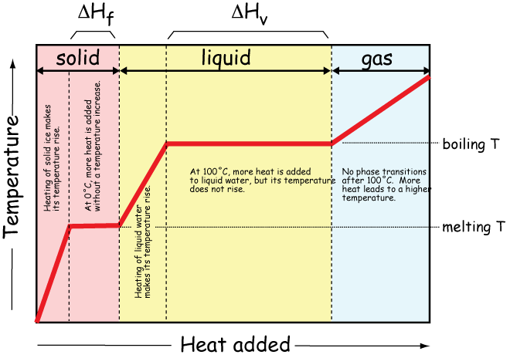

Slide 13
Summary
The heating curve is a useful tool to show us the changes in temperature, and energy as a sample is heated up. It give us detailed information about phases and phase changes of samples.

Slide 14
Big Ideas
During a change of state, the energy of the substance changes and NOT the TEMPERATURE.
Substances change state when they reach their melting, freezing, boiling, and condensation points.

